Slide 1
MGT 217
10/15/18

Slide 2

Notes:
Intro
My background
What we will be doing today
--relevant to you as engineers: Going out into the working world where these issues will come up
--overview of topic
--very basic introduction: We’re not getting into the various nuances of ethics; instead, focusing on application
--case study in groups, then class discussion
--how this will apply to your freshman design project
Discussion question: what is ethics? How would you define it?

Slide 3

What are ethics?
From Greek word, “ethos” = “character”
A set of moral principles which guide a person’s, or group’s, behavior

Slide 4
Case
Ralph Sims had worked for the US Government for many years as an engineer, rising to a fairly high managerial position. On retirement, he accepted an executive position with SuperCom, a company producing electronic equipment for the military.

Slide 5
Real-Life Engineering Case
Shortly after coming on board, Ralph was informed by a subordinate that, for a long time, a key test on an important product was not being made in the manner specified by the contract. This had been going on for several years and the subordinate felt very uncomfortable about it.
Ralph, who had considerable expertise in the technology involved, looked into the matter carefully. It turned out, that in his previous career, he had acquired some knowledge about the specified test. He found that a shorter, and hence less costly, test had indeed been substituted for the required one. But, after some study, he concluded that SuperCom’s test was actually as effective as the specified test.

Slide 6
The Four Component Model of Ethical Decision Making
Explains why an authority would choose to act unethically.
Suggests ethical behaviors result from a multistage sequence.
6-6

Slide 7
The Four Component Model of Ethical Decision Making, Cont’d
Moral awareness - when an authority recognizes a moral issue exists.
  Depends on characteristics of the authority & of the issue itself.
    Moral sensitivity - ability to recognize a decision has ethical content.
    Moral intensity - degree to which the issue has ethical urgency.

Slide 8
The Four Component Model of Ethical Decision Making, Cont’d
Moral judgment - when the authority identifies the morally “right” action.
  Theory of cognitive moral development argues that as people age, they move through stages of moral development.
6-8

Slide 9
Kohlberg’s Theory of Moral Development
Pre-conventional
  Rewards and punishments
Conventional
  Laws
Postconventional
  Universal human rights

Slide 10
The Four Component Model of Ethical Decision Making, Cont’d
Moral intent - degree of commitment to the moral course of action.
  Many unethical people know what they do is wrong.
    What influences moral intent?
      Moral identity (degree to which a person sees himself as moral)
      Situational pressures (e.g., rewards, incentives)

Slide 11
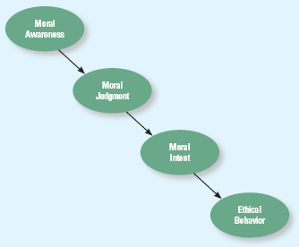
The Four Component Model of Ethical Decision Making
Figure 6-6
6-11

Slide 12
Keeping Your Colleagues Honest

